Slide 1
SOLUTIONS & SOLUBILITIES

Slide 2
TERMS
Solution: a homogeneous mixture containing particles the size of a typical ion or covalent molecule. (0.1–2.0 nm in diameter)
Colloid: a homogeneous mixture containing particles with diameters in the range 2–500 nm
Suspensions are mixtures with even larger particles, but they are not considered true solutions because they separate upon standing.
Solute: the dissolved substance in a solution
Solvent: the major component in a solution

Slide 3
A solution is saturated when no additional solute can be dissolved at a particular temperature
A Supersaturated solution can form when more than the equilibrium amount of solute is dissolved at an elevated temperature, and then the supersaturated solution is slowly cooled.
An Unsaturated solution is formed when more of the solute can dissolve in it at a particular temperature.

Slide 4
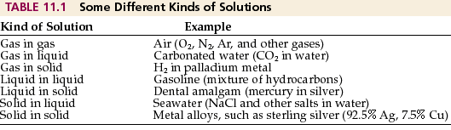
KINDS OF SOLUTIONS

Slide 5
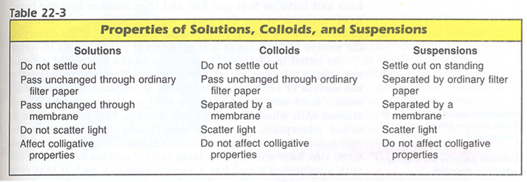

Slide 6
SOLUBILITY
The amount of solute per unit solvent required to form a saturated solution is called the solute's Solubility.
When two liquids are completely soluble in each other they are said to be Miscible.
Solubility is effected by Temperature. With increase in temperature solubility of most of the substances increases.
Most gases become less soluble in water as the temperature increases.

Slide 7
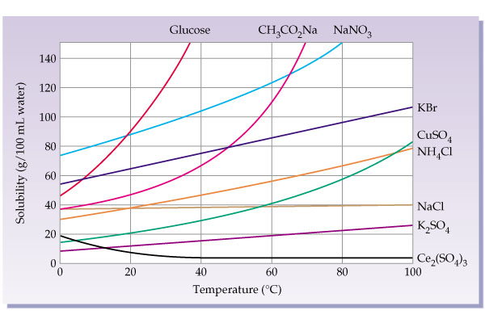
SOLUBILITY GRAPH OF SALTS IN WATER

Slide 8
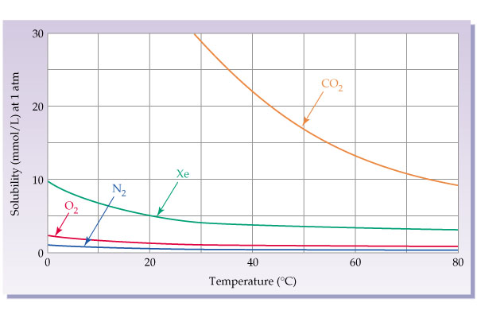
SOLUBILITY GRAPH OF GASES IN WATER
Pressure has little effect on the solubility of liquids and solids. The solubility of gases is strongly influenced by pressure. Gases dissolve more at high pressure.

Slide 9
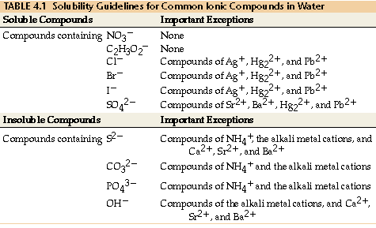
SOLUBILITY OF COMMON IONS IN WATER

Slide 10
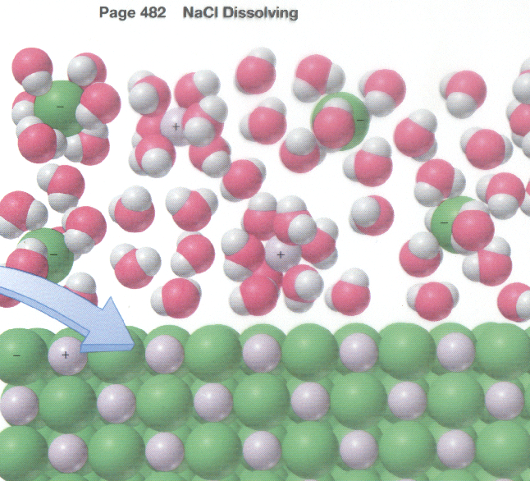
DISSOLUTION OF SODIUM CHLORIDE IN WATER

Slide 11
DONATED BY
MUHAMMAD ALI
To www.worldofteaching.com

